Slide 1
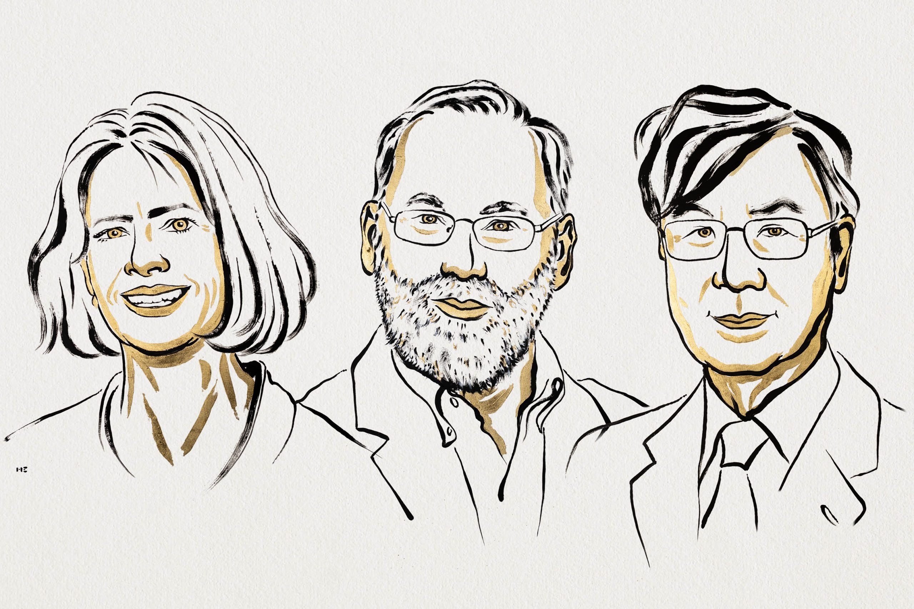
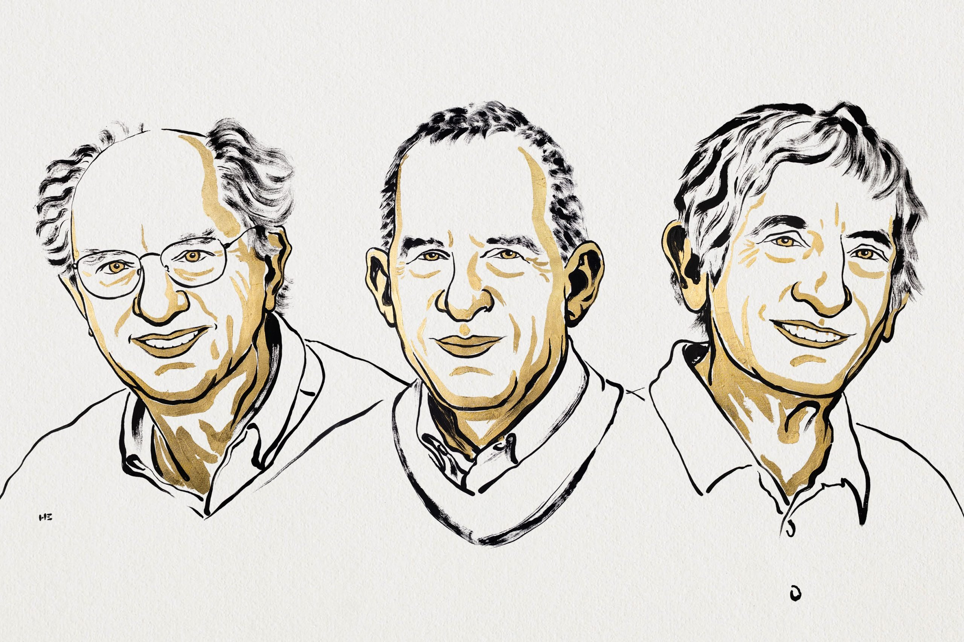
2025 Nobel Prizes!
Chemistry
TBD
Physiology or Medicine
Mary E. Brunkow, Fred Ramsdell and Shimon Sakaguchi - “for their discoveries concerning peripheral immune tolerance.”
Physics
John Clarke, Michel H. Devoret, and John M. Martinis - “for the discovery of macroscopic quantum mechanical tunnelling and energy quantisation in an electric circuit.”

Slide 3
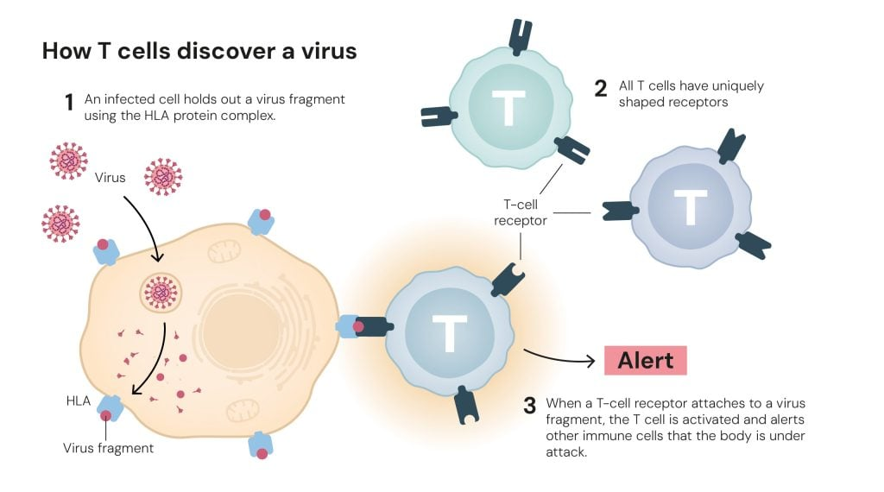
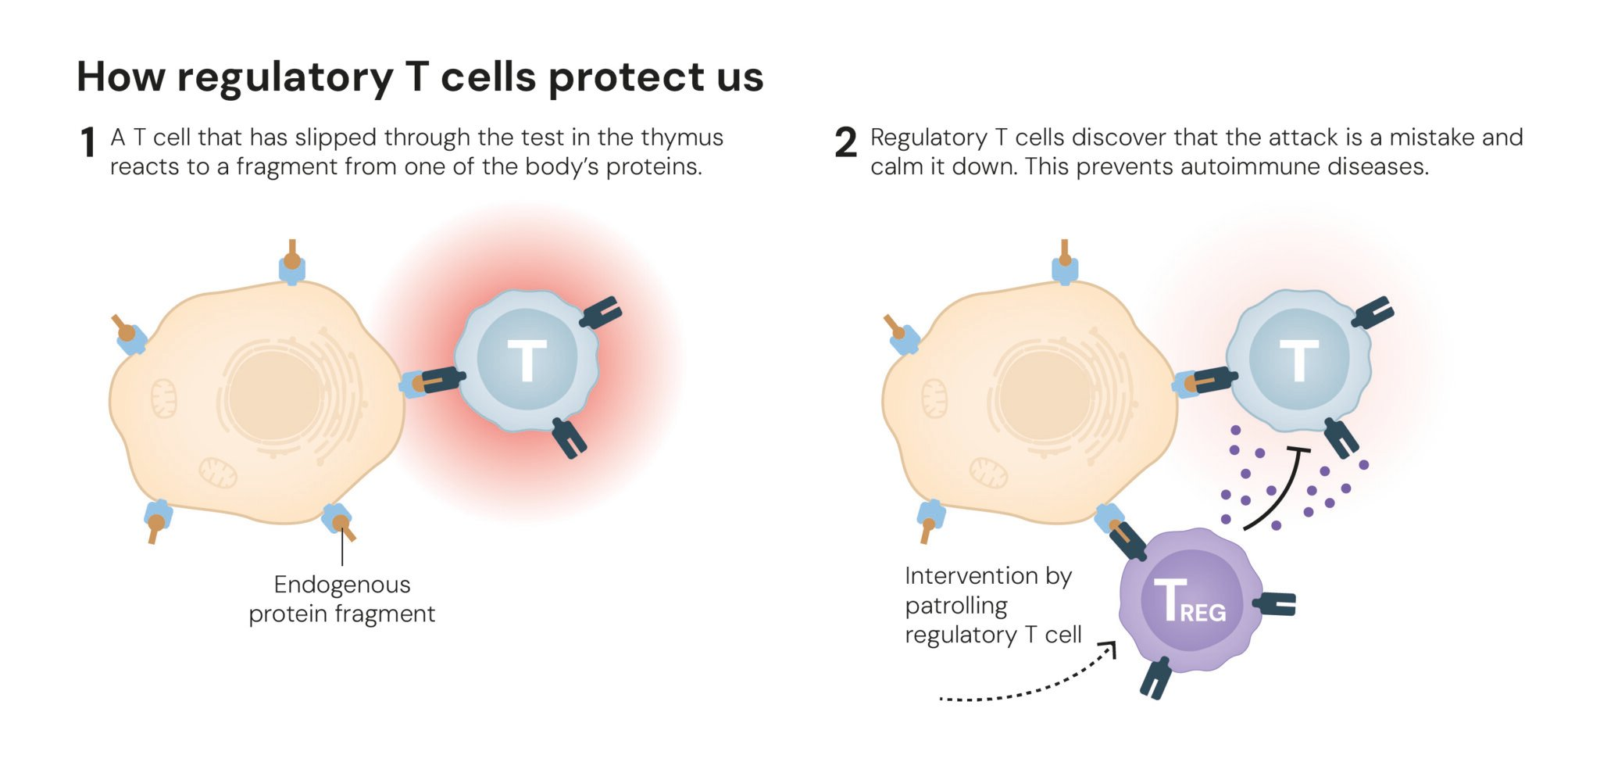
Regulatory T cells
Helper T cells: Patrol the body and alert other immune cells if there is an invader. [CD4+]
Killer T cells: Kill cell that have been infected. [CD8+]
Regulatory T cells: Calm the immune system by releasing cytokines. [CD25+ and CD4+]
“Forkhead box P3”, FOXP3: A gene that controls the development of Tregs (as a transcription factor).
Mutations in this gene cause a severe autoimmune diseases.
Now there are several clinical trials to control, engineer, and use Tregs:
⬆ with IL-2 for atopic dermatitis, suppressing inflammation, celiac disease, transplants.
⬇ in mAbs/CCR8 for cancer

Slide 4
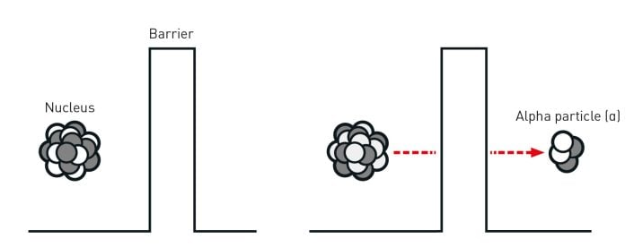
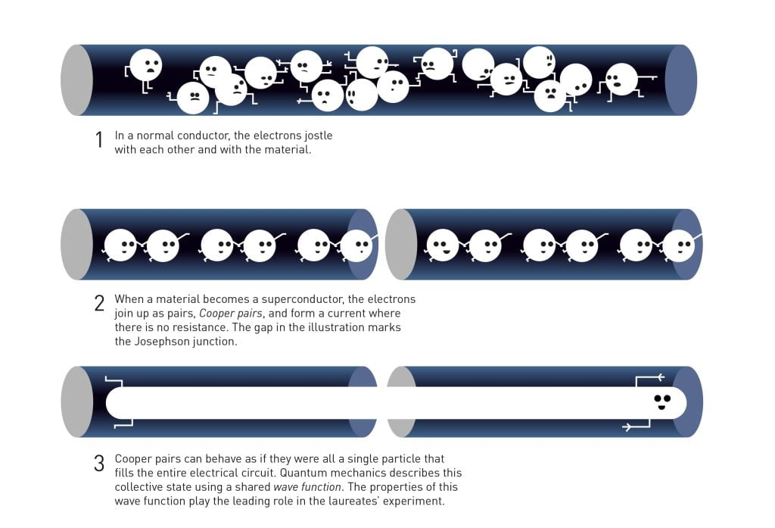
Macroscopic Quantum Tunneling
Quantum Mechanics: The science of tiny things like atoms, electrons, and photon
Quantum Tunneling: A particle passing through a medium. Usually only observable at microscopic scales.
The experiment: In an electric circuit between two superconductors, they placed a thin insulating barrier, forming a device known as a Josephson junction.
The current “tunneled” through it, but not as electrons…as a quantum state.
The electrons in the superconductors behave as one giant quantum particle.
This is the foundation for the development of superconducting qubits for quantum computing.

Slide 5
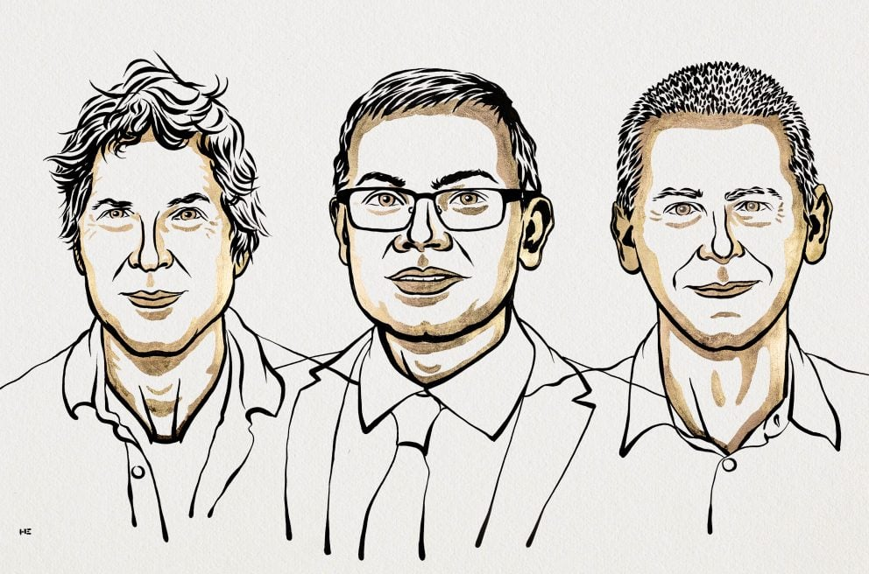
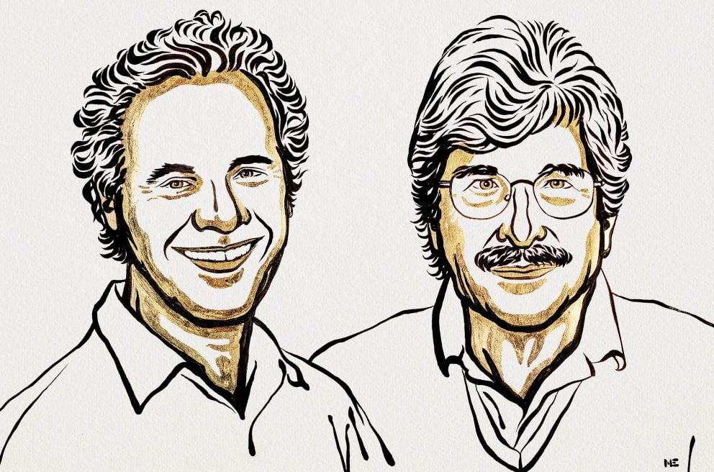
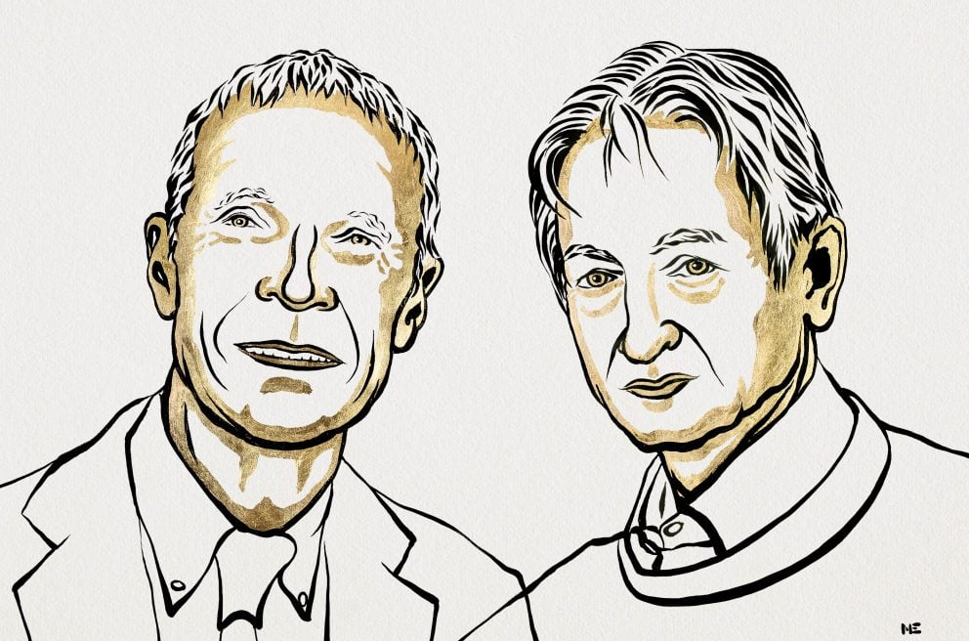
2024 Nobel Prizes!
Chemistry
David Baker - “for computational protein design”
Demis Hassabis and John M. Jumper - “for protein structure prediction”
Physiology or Medicine
Victor Ambros and Gary Ruvkun - “for the discovery of microRNA and its role in post-transcriptional gene regulation.”
Physics
John J. Hopfield and Geoffrey E. Hinton - “for foundational discoveries and inventions that enable machine learning with artificial neural networks.”

Slide 6
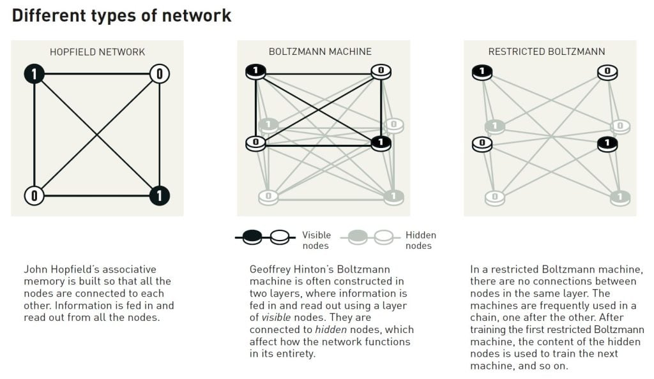
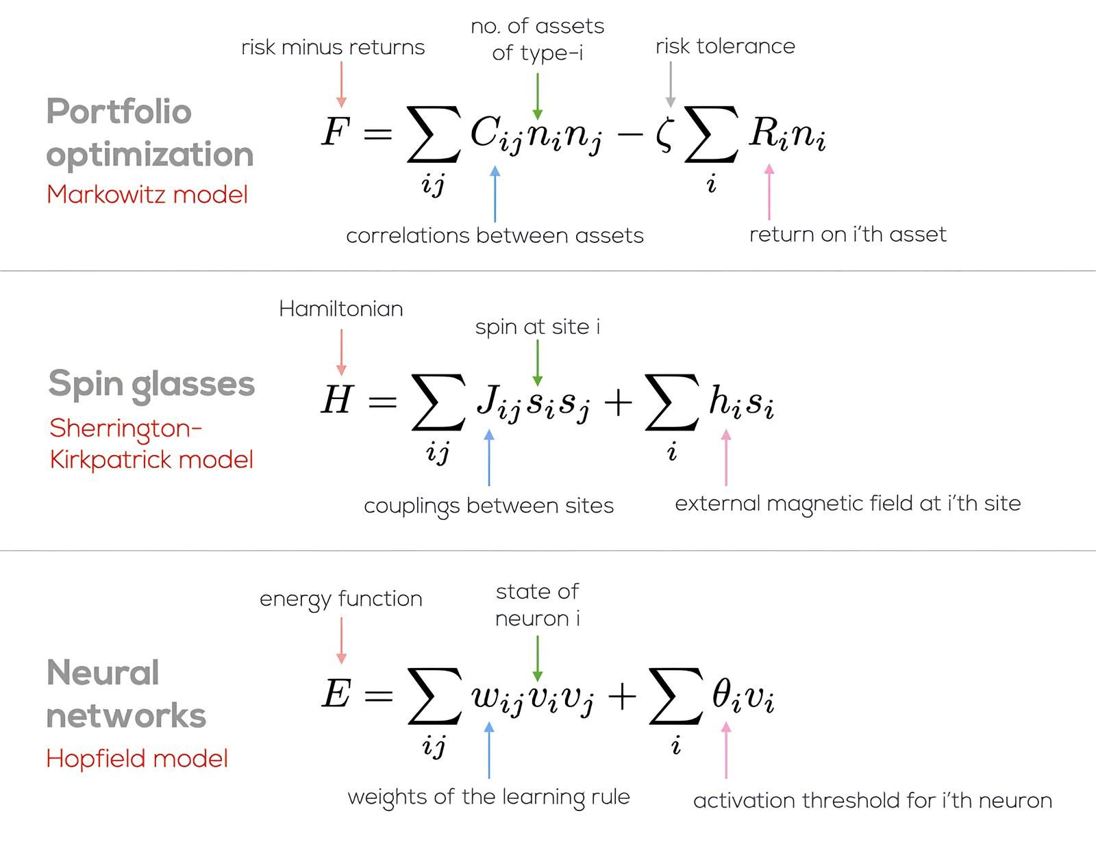
Physics? or AI?

Slide 7


















Some Azure Services
Functions
Batch
CycleCloud
Synapse
Databricks
Storage
Container Registry
Web Apps
Virtual Machines
Data Factory
SQL DB
Container Instances
CosmosDB
Power BI
PostgreSQL
AI Services /
OpenAI
ML Studio
Kubernetes Service

